Slide 1
Diffusion Maps

Slide 2
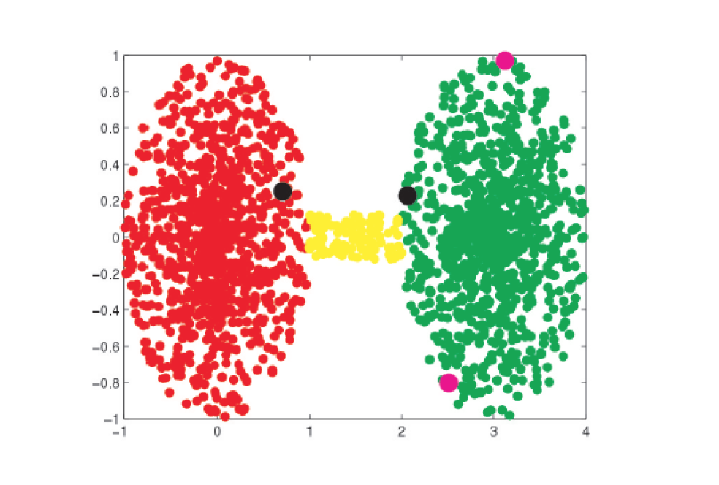
Euclidean Distance is Misleading

Slide 3
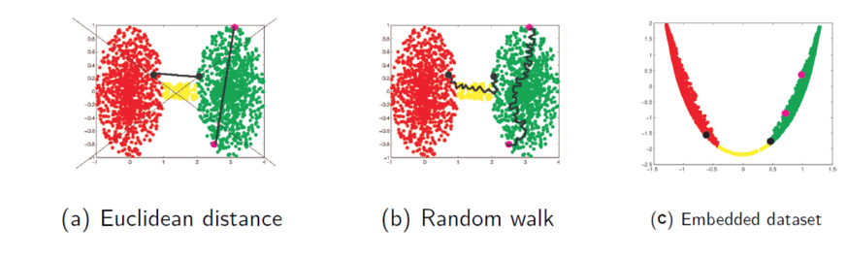
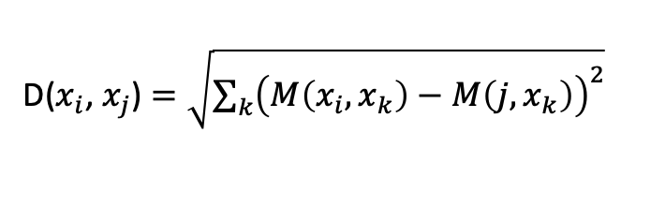
Diffusion Distance
D($x_{i}$, $x_{j}$) $=\sqrt{\sum_{k}{{\left(M\left(x_{i},x_{k}\right)−M\left(j,x_{k}\right)\right)}^{2}}}$
Euclidean distance in the diffusion embedding is diffusion distance
Diffusion distance can be interpreted as the overall difference in walking probabilites
after t steps when starting out in point x vs point y

Slide 4
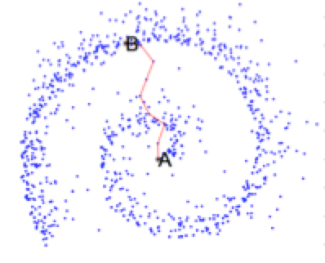
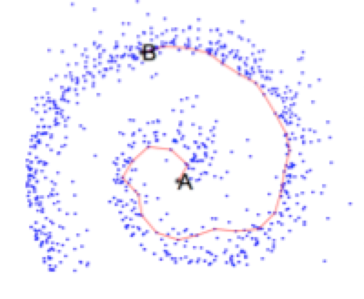
Diffusion Distance is Robust to Noise
Geodesic Distance
Diffusion Distance

Slide 5
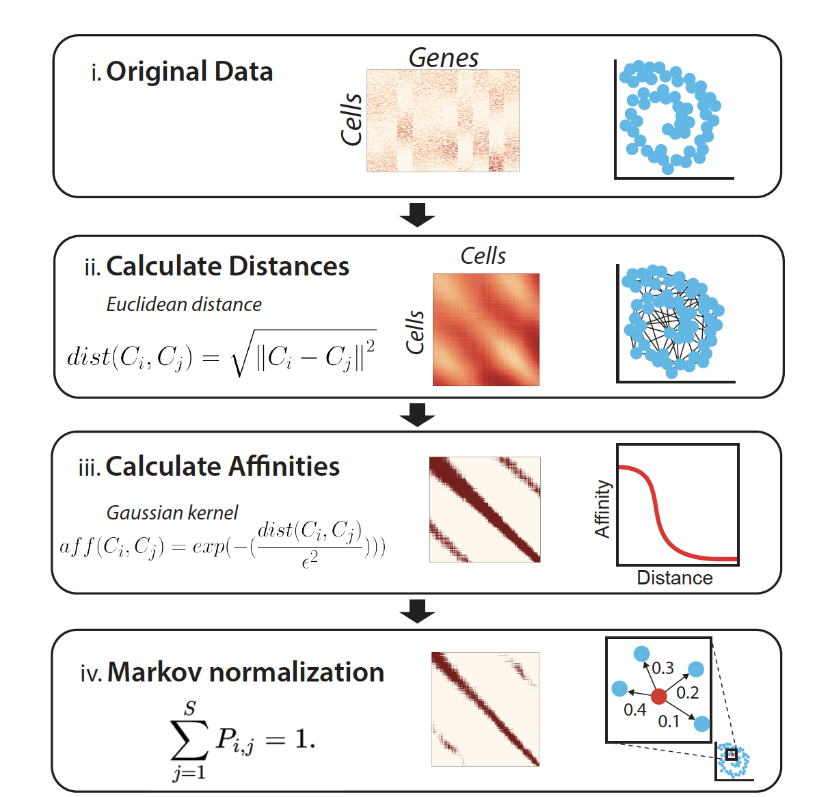
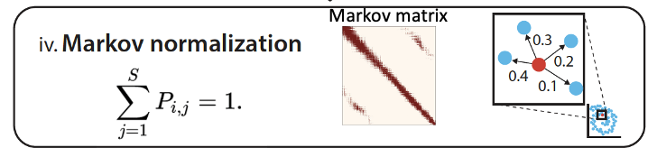
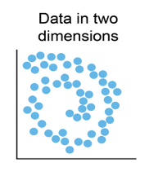
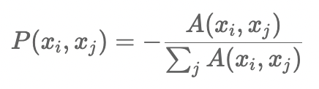
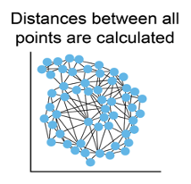
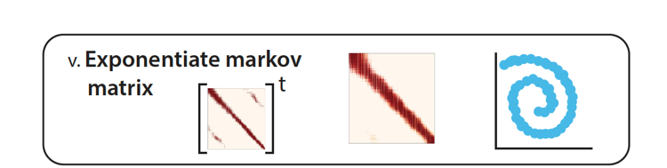

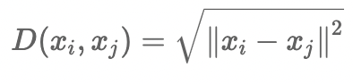
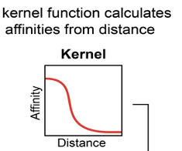
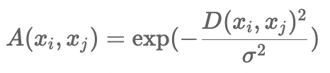
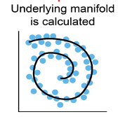
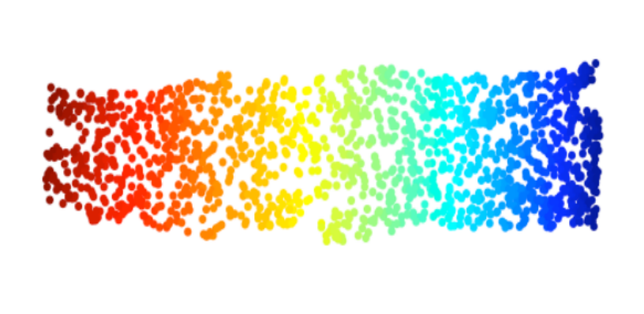
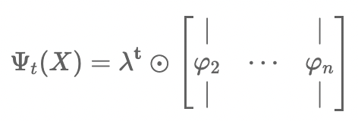
Diffusion Map Algorithm
Distance matrix
Manifold distance
is preserved
Powered Markov matrix
affinity matrix
VI Calculate diffusion map
Markov matrix
Eigendecomposition of M^{t}

Slide 6
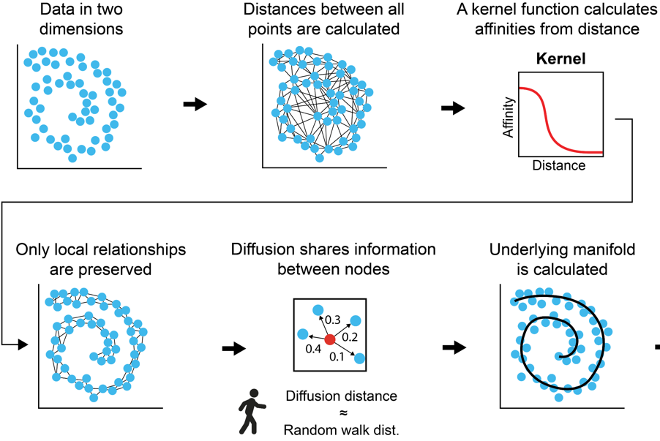
Diffusion Maps
1. compute distance matrix D
compute affinity matrix A
compute Powered Markov matrix P ^{t}
4. compute diffusion maps

Slide 7
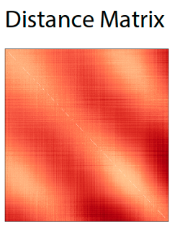
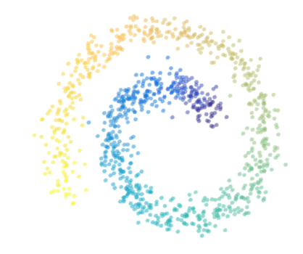
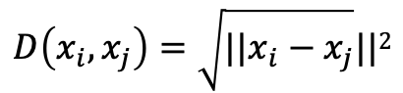
Distance Matrix
2D Swiss Roll Dataset
Heatmap
Entries are distances
$$D\left(x_{i},x_{j}\right)=\sqrt{||x_{i}−x_{j}}||2$$

Slide 8
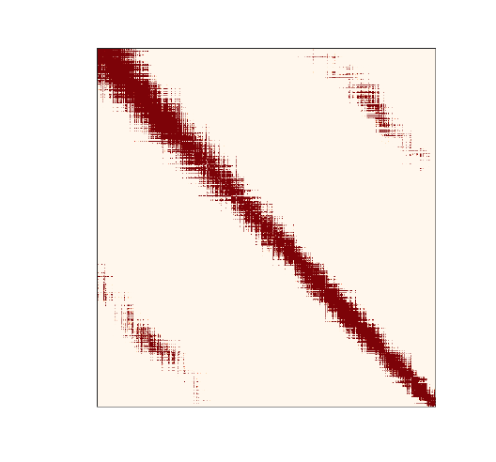
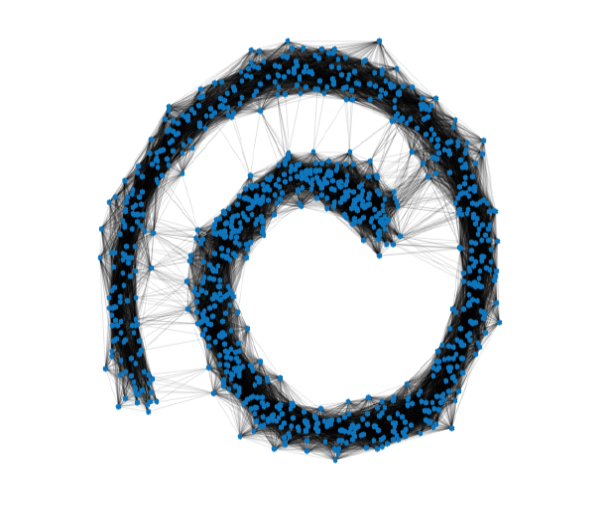
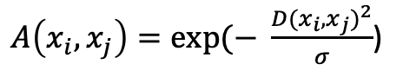
Affinity Matrix
Heatmap
Graph Representation
(Gaussian Kernel)
Entries are affinities
$A\left(x_{i},x_{j}\right)=exp⁡(− \frac{{D(x_{i},x_{j})}^{2}}{σ}$)

Slide 9
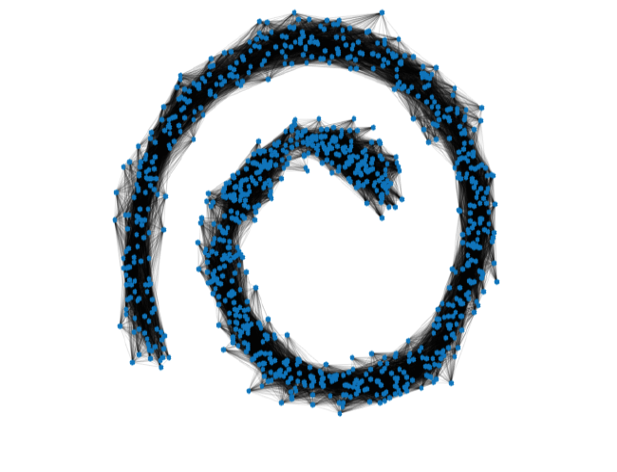
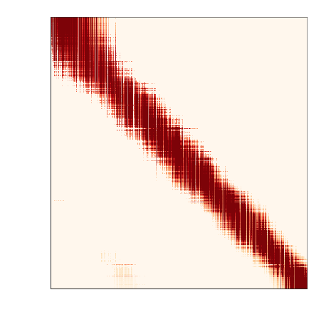

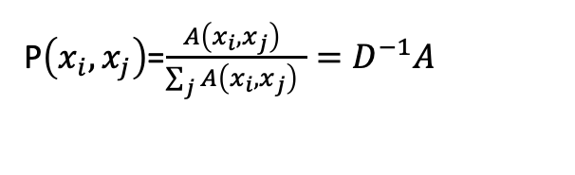
Powered Markov Matrix $P^{t}$
Heatmap
Graph Representation
Entries are row normalized affinities
P$\left(x_{i},x_{j}\right)$=$\frac{A\left(x_{i},x_{j}\right) }{\sum_{j}{A\left(x_{i},x_{j}\right) }}=D^{−1}A$

Slide 10
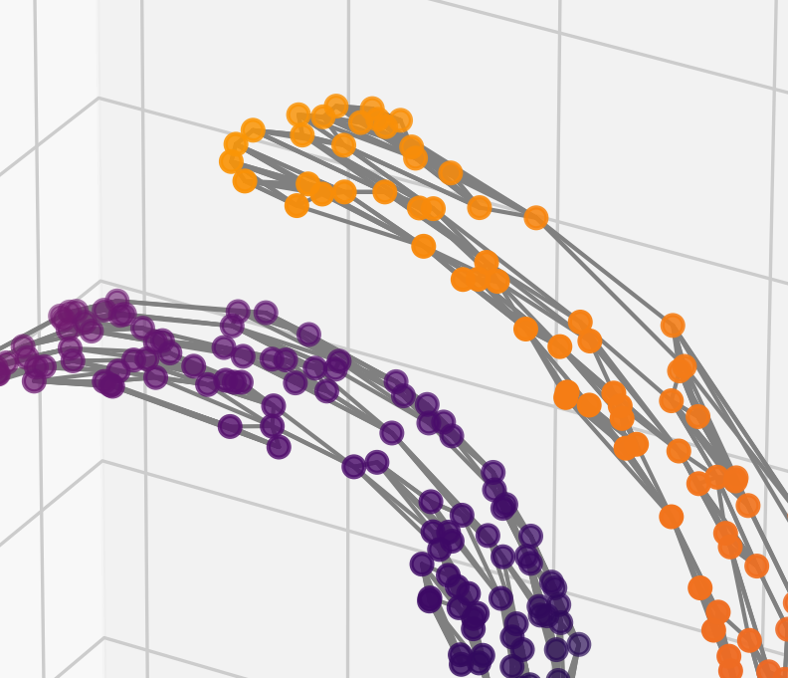
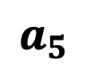
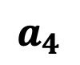
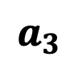
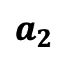
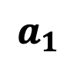
Transition Probabilities
$$a_{1}$$
$$a_{2}$$
.3
.35
$$a_{1}$$
$$a_{3}$$
.3
$$a_{4}$$
$$a_{2}$$
.05
$$a_{3}$$
$$a_{5}$$

Slide 11

Transition Probabilities
$$a_{1}$$
$$a_{2}$$
.3
.3
$$a_{1}$$
.4
$$a_{3}$$
$$a_{4}$$
$$a_{2}$$
$$a_{3}$$
t=0
$$a_{5}$$

Slide 12
Transition Probabilities
$$a_{1}$$
$$a_{2}$$
$$a_{1}$$
$$a_{3}$$
$$a_{4}$$
$$a_{2}$$
$$a_{3}$$
.1
.1
t=0
$$a_{5}$$

Slide 13
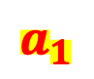
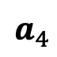
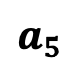
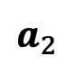
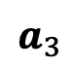
Transition Probabilities
t=1
$$a_{1}$$
$$a_{2}$$
.35
.3
$$a_{1}$$
$$a_{2}$$
$$a_{4}$$
$$a_{4}$$
$$a_{5}$$
$$a_{3}$$
.3
$$a_{3}$$
.05
$$a_{5}$$

Slide 14
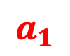
Transition Probabilities
t=2
$$a_{1}$$
$$a_{2}$$
.3075
.225
$$a_{1}$$
$$a_{2}$$
$$a_{4}$$
.185
$$a_{4}$$
$$a_{5}$$
$$a_{3}$$
.225
$$a_{3}$$
.0575
$$a_{5}$$

Slide 15
Transition Probabilities
t=10
$$a_{1}$$
$$a_{2}$$
.224
.224
$$a_{1}$$
$$a_{2}$$
$$a_{4}$$
.224
$$a_{4}$$
$$a_{5}$$
$$a_{3}$$
.224
$$a_{3}$$
.104
$$a_{5}$$

Slide 16
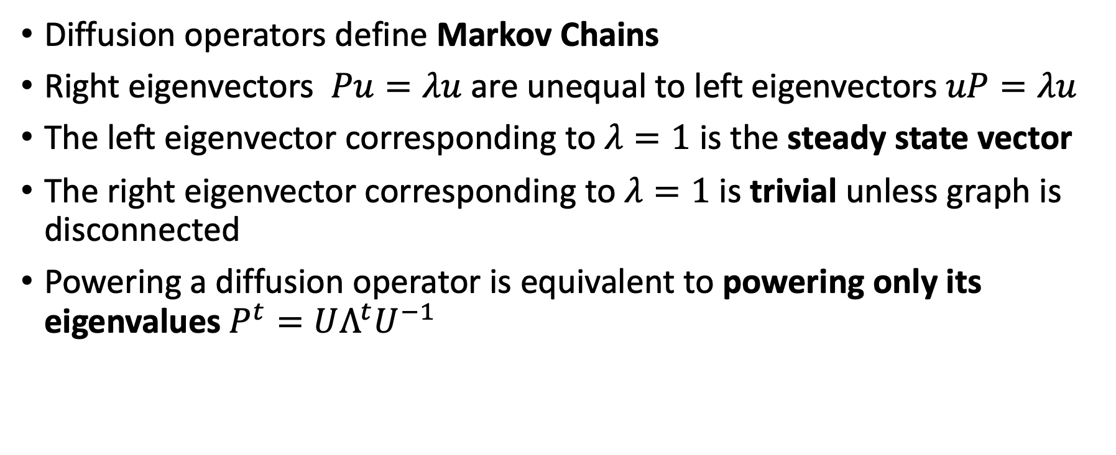
The Diffusion Operator
Diffusion operators define Markov Chains
Right eigenvectors $Pu=λu$ are unequal to left eigenvectors $uP=λu$
The left eigenvector corresponding to $λ=1$ is the steady state vector
The right eigenvector corresponding to $λ=1$ is trivial unless graph is disconnected
Powering a diffusion operator is equivalent to powering only its eigenvalues $P^{t}=UΛ^{t}U^{−1}$

Slide 17
DM = Eigenvectors of Markov Matrix
The Diffusion MAP is the set of eigenvectors of the Markov matrix
Unlike PCA which finds the linear paths of greatest variation
Eigenvalues similar to PCA explain the extent of variation explained by the diffusion component
But first diffusion vector has a special meaning

Slide 18
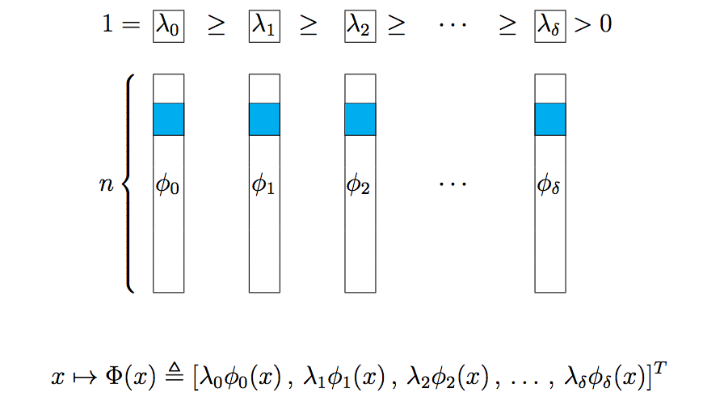
Diffusion Maps = weighted right eigenvectors
eigendecompositions of powered Markov Matrix
remove 1st trivial vector
eigenvalues
eigenvectors
n: sample size
[Coifman, Lafon, ACHA 2006]

Slide 19
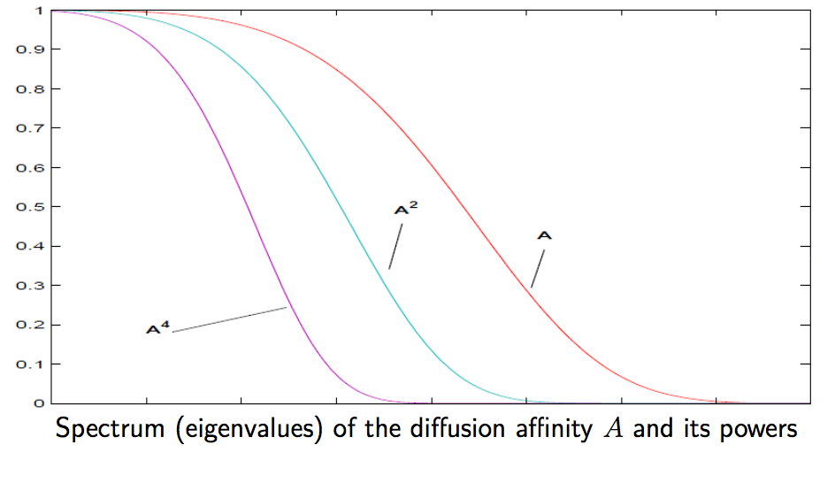
Powering: Spectral View
“Low pass filters” the eigenvalues

Slide 20
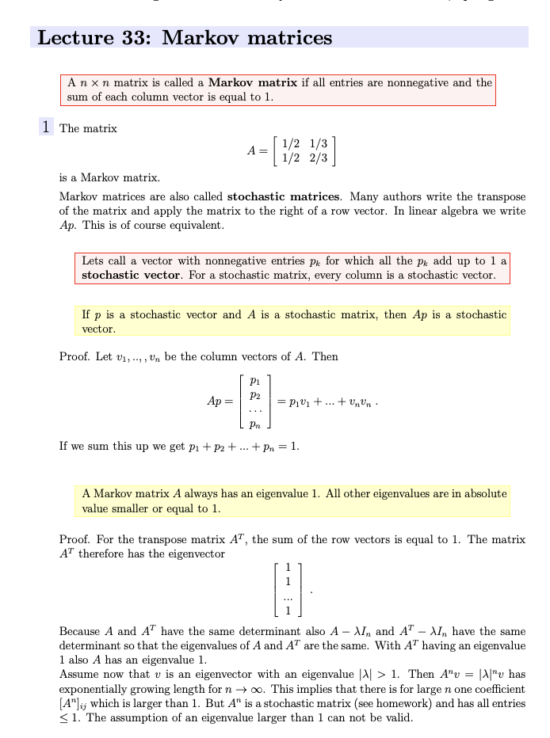
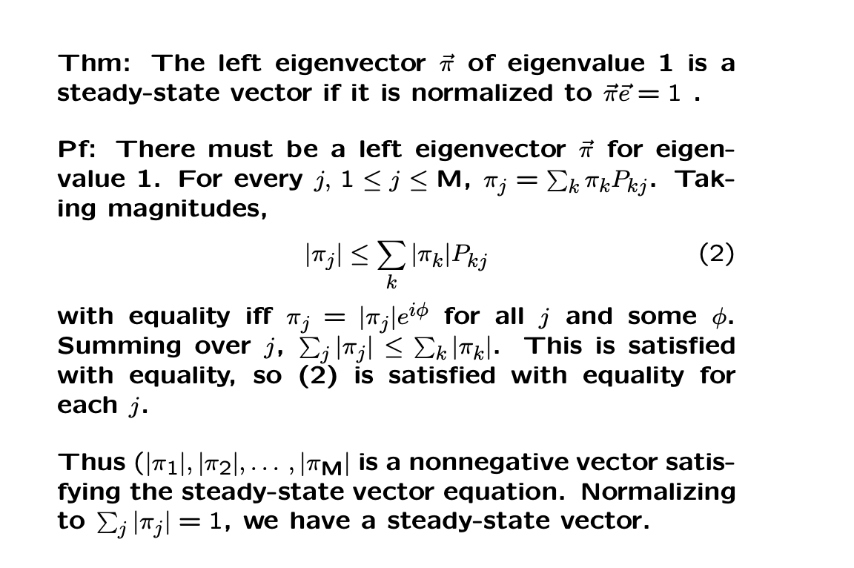
Markov Chain questions?
Why is 1 an eigenvalue?
Why is the left first eigenvector a steady state distribution?
Why is this a density estimate?
A steady state of a Markov matrix is an eigenvector with eigenvalue 1, such that the entries are positive and sum to 1.

Slide 21
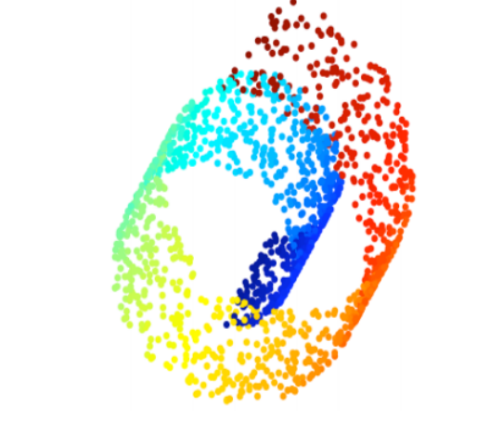
Uncoiling the space
3 D Swiss Roll Dataset
2D Diffusion Maps of Swiss Roll
First non-trivial eigenvector DM1 tracks the most prominent non-linear path

Slide 22
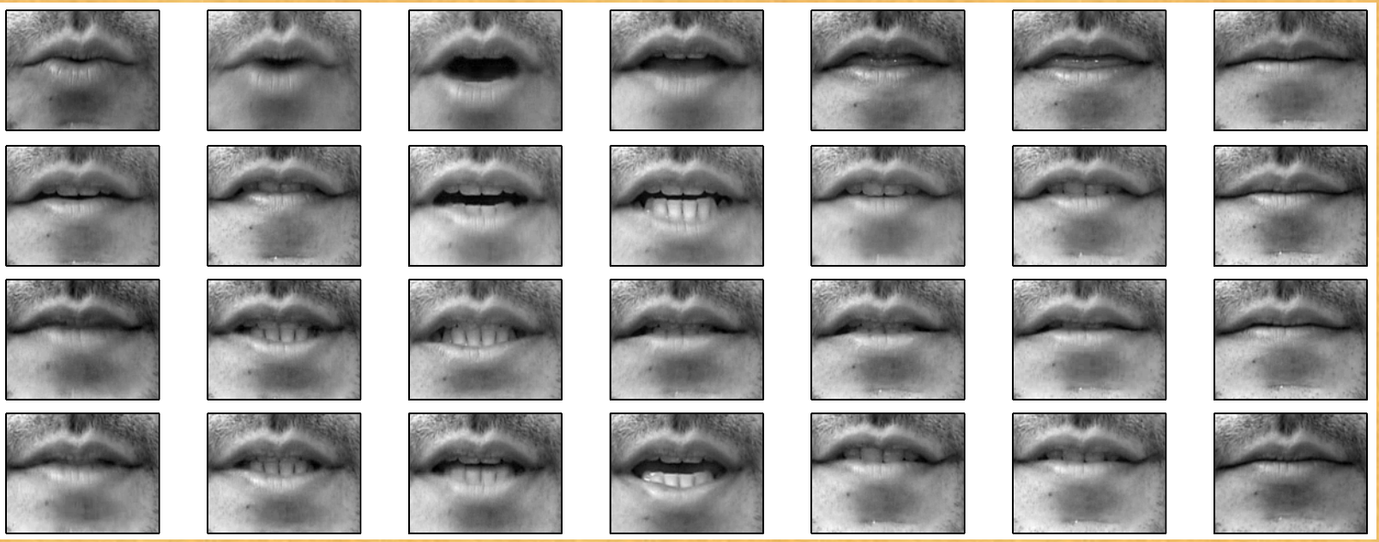
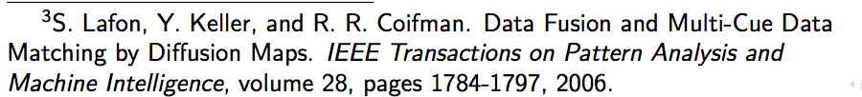
Lips Dataset: Spoken Digits of One

Slide 23
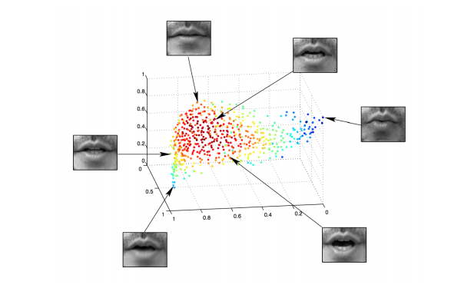
Lips Manifold is in 2D
1d: Opening of mouth
1d: portion of teeth visible

Slide 24
Exercises
Try to change the gamma parameter on the swiss roll
Try to change the kernel type on the swiss roll, what works best?
Try to create a dataset that is better separated with KPCA

Slide 25
Exercise
Create a graph with differences in density
Encode the affinity/adjacency matrix
Markov normalize
Try diffusing and see how probabilities change

